Slide 1

While - Loop
Lecturer
Rokas Slaboševičius
Data

Slide 2
Today you will learn
Cycles - While
While
Do While
01
04
While examples in reality
Do While example in reality
02
04
While in While
03

Slide 3
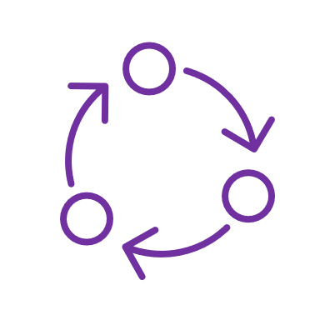
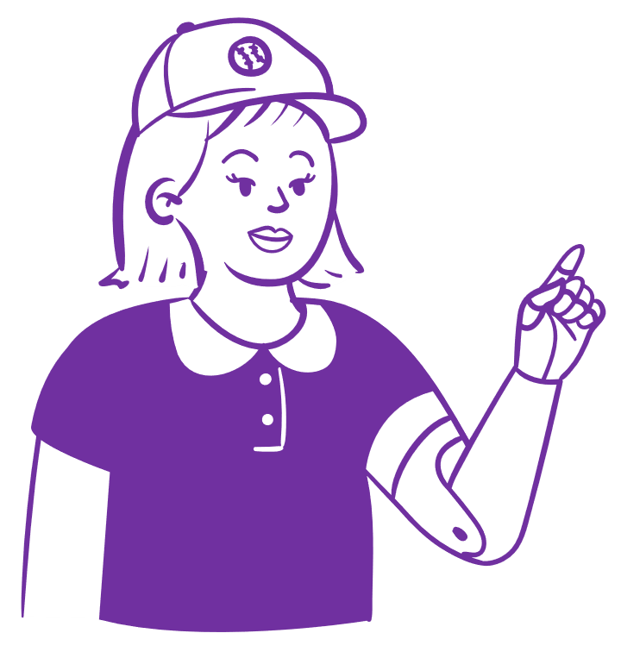
While
Cycles - While
"The While loop is one of the main loops used in the C# programming language.
This loop allows the code to be executed as long as a certain condition remains true.
It is a great tool for repeating certain actions until a certain condition occurs, or until the condition becomes false.

Slide 4
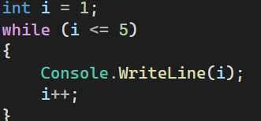
While
Cycles - While
The "While" loop has a simple structure. First, we specify the condition we want to check before each iteration of the loop.
If the condition is true, the body of the loop (the code we want to execute) will be executed.
The loop then returns to checking the condition and repeats this process until the condition is false.

Slide 5
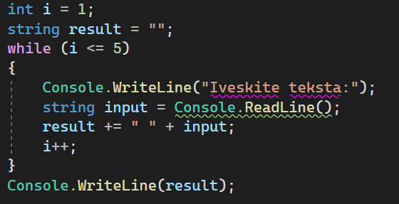
While
Cycles - While
The "While" loop has great flexibility because we can check the condition at any time and perform different actions in the loop body.
This allows us to adapt the cycle to many different situations.
For example, we can use a "while" loop to read and process inputs from the user until we get the desired result.

Slide 6
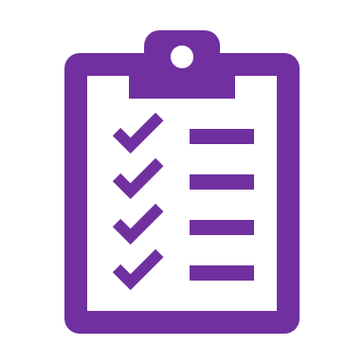
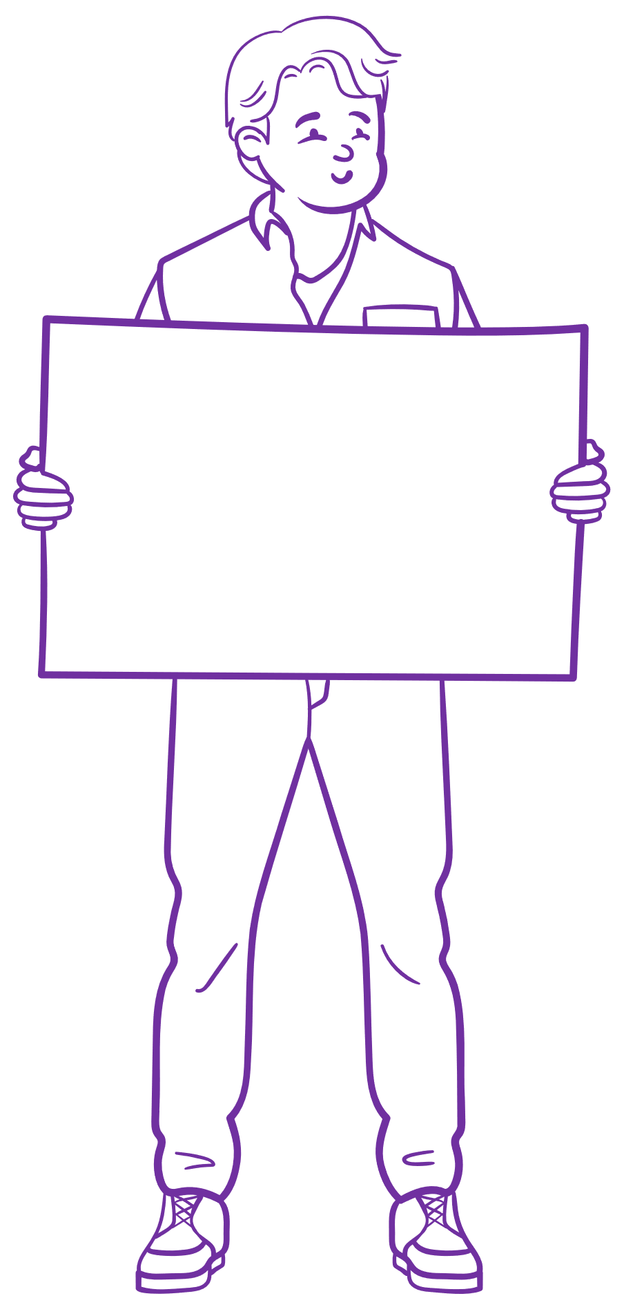
While
Cycles - While
It is important to ensure that the condition in the loop does not eventually become invalid, so that the infinite loop of the loop does not get stuck.
To ensure this, we need to update the condition at each iteration of the loop.
This can be done by changing values, adding or subtracting, or otherwise modifying the clause to make it ultimately false.

Slide 7
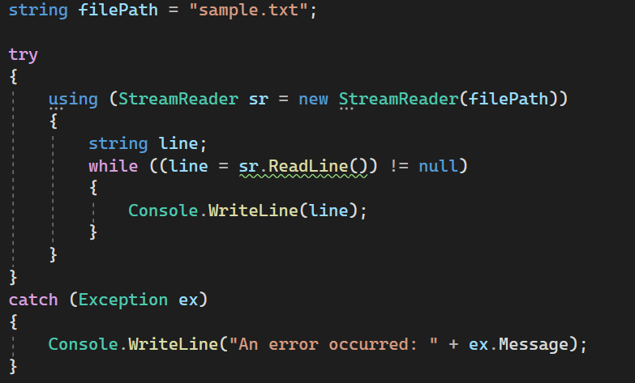
While
Cycles - While
The "While" loop is very useful when we have an unknown or variable number of iterations.
For example, we can use a "while" loop to read data from a file until we reach the end of the file.
This allows us to work efficiently with data that can vary from one time to the next.

Slide 8

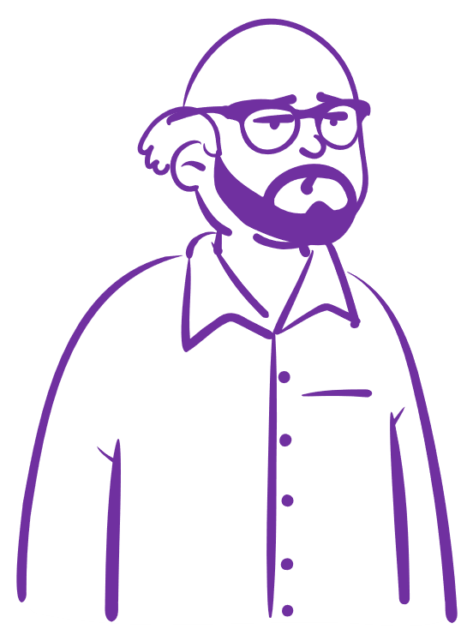

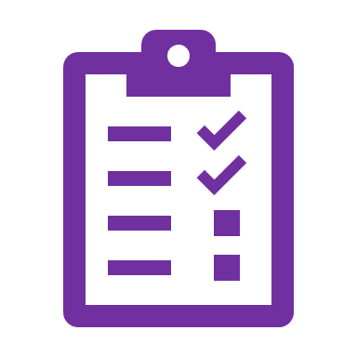
While examples in reality
Cycles - While
You can compare the "while" cycle to a shopper in a shopping centre. The shopper can perform certain search and purchase operations as long as there are items in the store for the desired purchase list.

Slide 9

While examples in reality
Cycles - While
Going home: you can compare the "while" cycle with going home. For example, when you are travelling on holiday, there may be a number of things you have to do before you get home.
You can have a list of places you want to visit and go through them one by one until you reach your destination.
Every time you visit a place, you check whether you have reached your destination. If not, continue your journey until you reach the desired end.

Slide 10
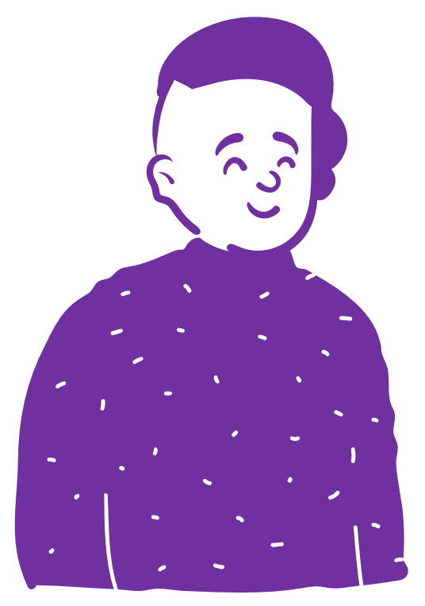
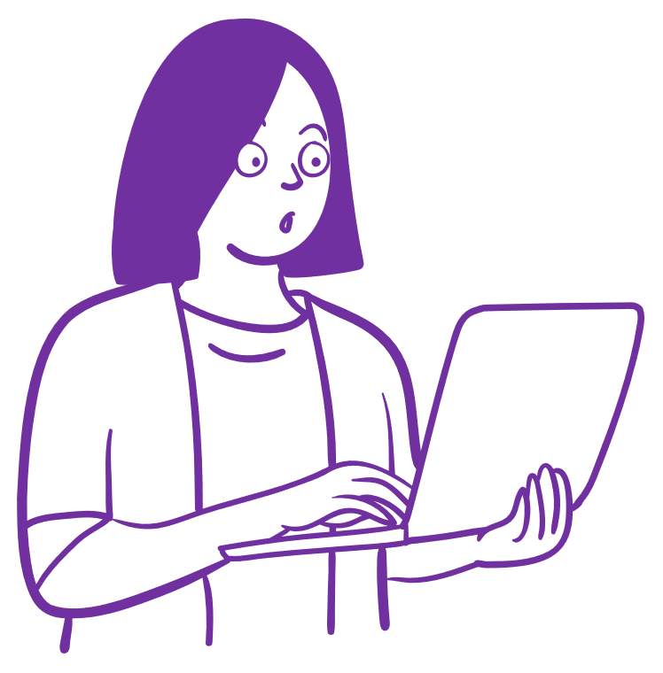
While examples in reality
Cycles - While
You can compare the "while" cycle with teacher consultations.
For example, if you are a student and you have questions about a certain topic, you can go to your teacher for a consultation.
You walk into the office, ask your questions and get an answer.
You may have more questions, so you repeat the consultation until all your questions are resolved and your understanding is secured.
In this analogy, the consultation acts as a "while" loop, and your questions and answers are each iteration until you reach the goal of understanding.

Slide 11
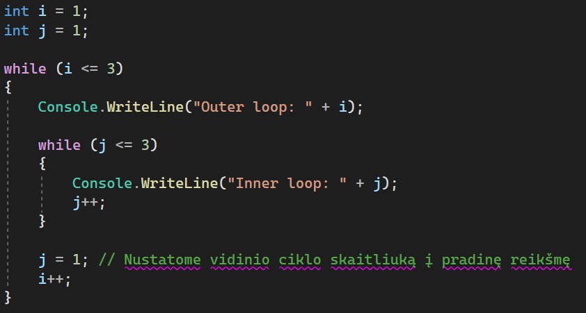
While in While
Cycles - While
The "While" loop can be a useful and powerful tool in programming, allowing us to create more complex logical structures in a programme.
In addition, one variant of this structure is called a "while" loop inside another "while" loop. This means that one "while" loop can be embedded in the body of another "while" loop, allowing us to further extend and control the execution flow.
This cycle cascading technique can be applied to a wide range of tasks and problems.
It is important to check the conditions and properly manage the execution of each cycle to avoid endless looping.
When a while loop is properly used inside another while loop, it is possible to create efficient and flexible program structures that meet specific task requirements.

Slide 12

Cycles - While
Task 1
Write a "while" loop that prints the numbers 1 to 5 to the console.
Modify the first task to follow the first cycle with a second cycle that prints numbers from 5 to 1.
Write a "while" loop that prints all even numbers between 2 and 10 to the console.
Modify the second problem so that the first cycle is followed by a second cycle that prints odd numbers from 1 to 9.
Write a "while" loop that asks the user to enter numbers until the number entered is greater than 100.
Modify the third problem so that the first cycle is followed by a second cycle that asks you to enter numbers as long as the number entered is positive.

Slide 13

Cycles - While
Task 2
Write a "while" loop that calculates and prints a factorial from the input number.
Modify the fourth problem so that the first cycle is followed by a second cycle that calculates and prints the factorials of all the numbers entered until a negative number is entered.
Write a program that asks the user to enter a positive number and then outputs the digits separately. For example, if the number 12345 is entered, the program should output the following digits one by one: 1, 2, 3, 4, 5.
Write a program that asks the user to enter the number n and then derives a triangle of stars using "while" loops. For example, if the number 5 is entered, the program should output the following triangle:

Slide 14
Cycles - While
Task 3
Write a program that asks the user to enter an integer and returns that number. If the user enters a wrong number, the program should inform the user that a wrong number has been entered and ask them to enter it again. Until the user enters the correct number, the method must keep asking for characters. Example Input and Output: Input: abc Output: Wrong input. Please enter an integer: Input: 123 Output: You entered the number: 123
Write a program that asks the user to enter the number they want to raise by a degree and then asks them to enter the number of degrees they want to raise. The number raised by the given degree should be output to the screen. Example Input and Output: Input: 2 Input: 3 Output: 2 raised to the power of 3 is 8
Write a program that outputs groups of numbers on a single line as follows: -> 1 -> 11 -> 111 -> 1111 -> 11111 -> ....... The program should ask for the number of numbers and the number of groups. Check that you have entered a number and not text. Example Input and Output: Input: Number: 3 Input: Groups: 4 Output: 3 -> 33 -> 333 -> 3333

Slide 15

Cycles - While
Task 4
Write a program that asks the user to enter an integer and should draw a triangle based on the number entered, as in the example below:
Write a program that asks the user to enter the amount of money they want to withdraw from an ATM. The program must output to the screen using a while loop when and how much change is given to the user. For example: €50, €50, €20, €10 (the user has entered €130). Max bank note(bill) € 50

Slide 16
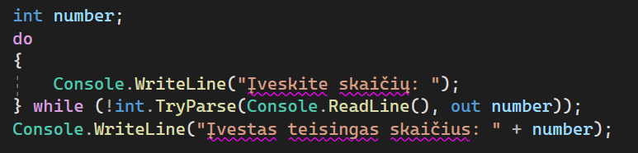
Do While
Cycles - While
The Do While loop is another iteration control structure used in programming.
This loop is very similar to the "while" loop, but with an important difference: the condition is checked after each iteration of the loop.
This means that the cycle is always executed at least once, even if the condition is incorrect to begin with.
This cycle is useful when we want to ensure that certain actions are carried out at least once, regardless of the correctness of the condition. It can also be used when we want to allow the user to perform certain actions and check the condition only after the actions have been performed at least once.

Slide 17
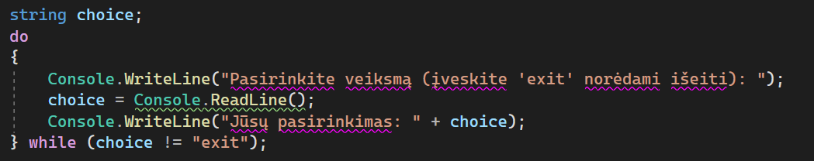
Do While
Cycles - While
We may have a situation where we want to show a message and ask the user if they want to continue or end the application.
Although the user's first answer may be "no", we still want to show the message at least once.
In that case, the DoWhile loop would be a good choice as it would ensure that the message is displayed and the user is given the opportunity to take action, even if the first answer is "no".

Slide 18


Do While example in reality
Cycles - While
We can imagine going to a dance class and learning a new dance. Going into the class, we don't know if we will do well. But the teacher encourages us to start dancing and keeps telling us that the exercises will be repeated until we reach a certain level.
So we start dancing and learning the dance steps. Whether we get it right or not, we continue learning and repeating the dance steps. Only after each iteration of the dance does the teacher check our progress and tell us what needs to be improved or corrected.

Slide 19
Cycles - While
Task 5
Write a program that allows the user to enter numbers until they choose to finish. The program must calculate the sum of all the numbers entered and display it. The user must be allowed to enter any number, and if he wants to continue entering, the program must allow him to do so. If the user enters "Finish" (whether upper or lower case) the screen should print the final result.
Password verification. Write a program that allows the user to enter a password until they enter the correct password. The initial correct password can be set in the program code. The user must be allowed to enter the password multiple times until the correct password is entered
Write a program that generates a random number between 1 and 100 (Math.Random). The user must be allowed to guess this number. The program must show whether the user's guess is greater or less than the generated number. The user will be allowed to guess until the correct number is guessed

Slide 20
Cycles - While
Project 1
Extend your Lesson 3 project by writing menus and scripts for the game using while or doWhile loops and Math.Random(). At the start of the game you should ask for a username, and the game should accumulate virtual points for good solutions. For example, if the player comes to a swamp and encounters an ogre, the player should be able to fight the ogre until the player has more than 100 life points. The player's combat mechanism could be based on the "paper, scissors, stone" principle. The player has to choose one of 3 attacks, and the ogre is randomly generated an attack, and the cycle checks whether the player has lost life points or taken ogres. For example, a high attack beats a low attack, a low attack beats a medium attack, a medium attack beats a high attack and so on.

Slide 21

Cycles - While
References
https://learn.microsoft.com/en-us/dotnet/csharp/language-reference/statements/iteration-statements
https://learn.microsoft.com/en-us/dotnet/csharp/language-reference/operators/null-coalescing-operator
https://learn.microsoft.com/en-us/dotnet/csharp/language-reference/builtin-types/nullable-value-types
https://learn.microsoft.com/en-us/dotnet/csharp/language-reference/operators/null-forgiving

